Slide 1








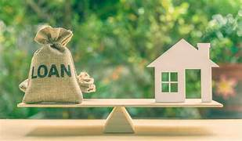
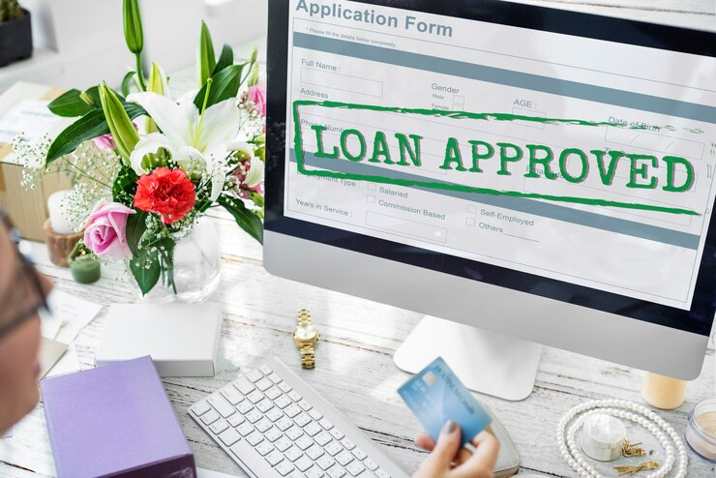
ML Project – “Capstone Project Of Loan Approval”
- Presented By “Nutan Zine”.

Slide 2

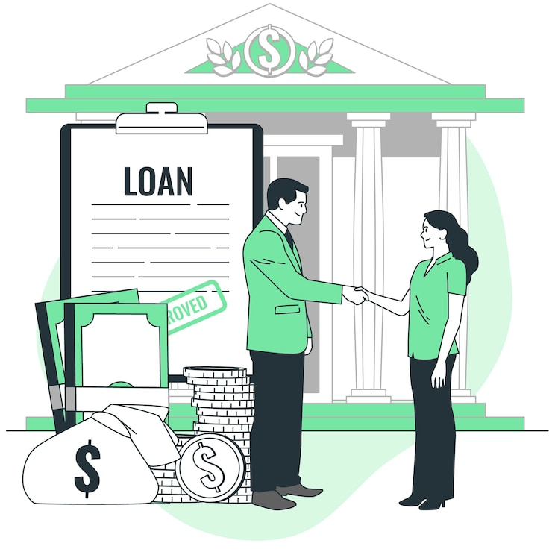

RECREATION DESIGN
Problem Statement: “Capstone Project Of Loan Approval Prediction”
The objective of this capstone project is to develop a machine learning model that can accurately predict whether a loan status will be approved or not based on applicant details such as self employeed,cibil score, education, loan amount, bsnk asset values, residential asset values, income annum and other relevant factors.
This predictive system will assist financial institutions in automating the loan approval process, minimizing human bias, and making faster, data-driven decisions. The model will be trained on historical loan application data and evaluated on its accuracy, precision, recall, and overall effectiveness in identifying eligible applicants.

Slide 3




Develop a Predictive Model Build a machine learning model to predict whether a loan application should be approved or not based on Loan Status. Automate Loan Approval Process Help financial institutions reduce manual workload by automating the loan approval decision-making process. Improve Decision Accuracy Enhance the accuracy and consistency of loan approval decisions using data-driven insights. Identify Key Influencing Factors Analyze and determine which applicant attributes (e.g., income, cibil score) have the most impact on loan approval. Minimize Human Bias Ensure fair and unbiased evaluation of loan applications by reducing the influence of human subjectivity. Ensure Business Efficiency Speed up the loan approval workflow, improving customer experience and reducing processing time. Provide Model Explainability Use tools like SHAP or LIME to explain the model’s decisions, increasing transparency and trust. Enable Real-time Predictions Design the system to support real-time or near real-time loan decision-making for practical deployment. Evaluate and Compare Models Test different machine learning algorithms (e.g., Logistic Regression, Random Forest, Decision Tree) and select the best-performing one. Build a User-friendly Interface (Optional Objective) Develop a web-based interface where users can input data and receive predictions instantly.
Objectives :

Slide 4




RECREATION DESIGN
Dataset Columns -
There are Total 13 Columns in “Capstone Project Of Loan Approval ”
'loan_id', ' no_of_dependents', ' education', ' self_employed', ' income_annum', ' loan_amount', ' loan_term', ' cibil_score', ' residential_assets_value', ' commercial_assets_value', ' luxury_assets_value', ' bank_asset_value', ' loan_status'

Slide 5

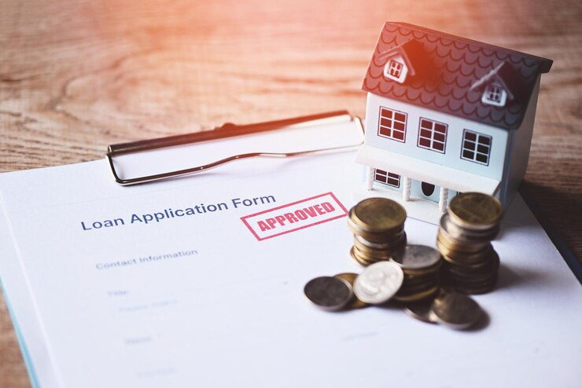

STEPS TAKEN IN DATASET ANALYSIS AND MODEL BUILDING
Table Of Contents –
1. Importing Data
2. Exploratory Data Analysis
3. Data Cleaning
4. Logistic Regression
5. Dicision Tree
6. Random Forest
7. SVM
8. K Nearest Neighbors
9. Choosing a K Value
10. Evaluation

Slide 6

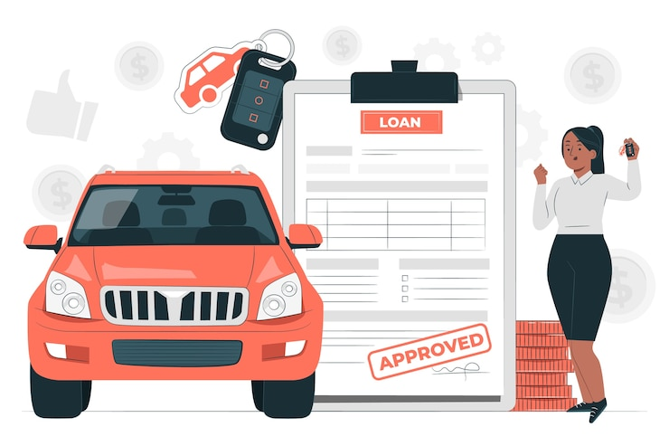


RECREATION DESIGN
EDA - Target Variable : loan_status
IN EDA Catplot, Displot, Box Plot,
Sub plot,Rel Plot, HeatMap charts have taken.
No Of Dependence , Self
Employeed status,Loan status,Education Status have found. Label Encoding has done & Outlier Removal has to be done on Box Plot. In this way, EDA Is Done.

Slide 7


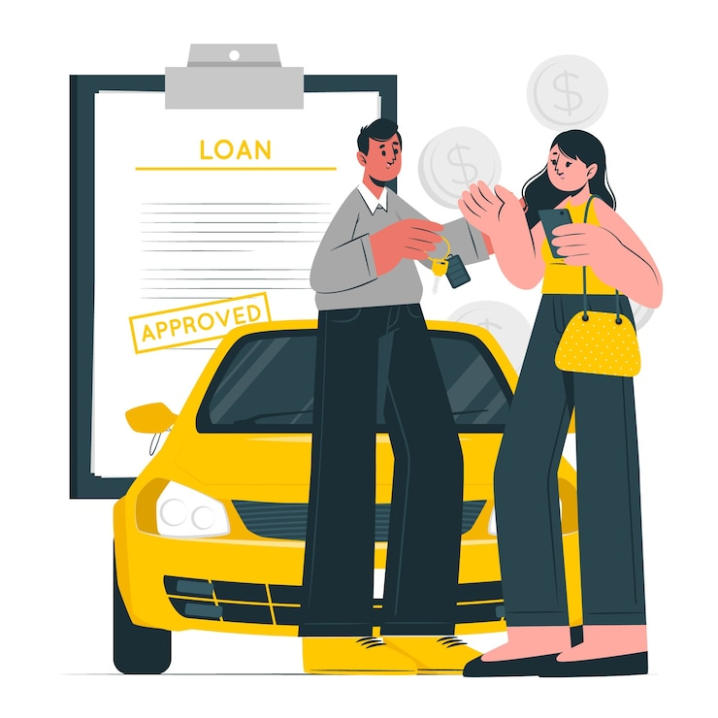

RECREATION DESIGN
Graphs Used for Exploratory Data Analysis :
1. Catagorical Plot
2. Distribution plot
3. Sub-Plot (Pie Chart)
4. Box Plot
5. RelAtional Plot
6. Heat – Map Plot

Slide 8




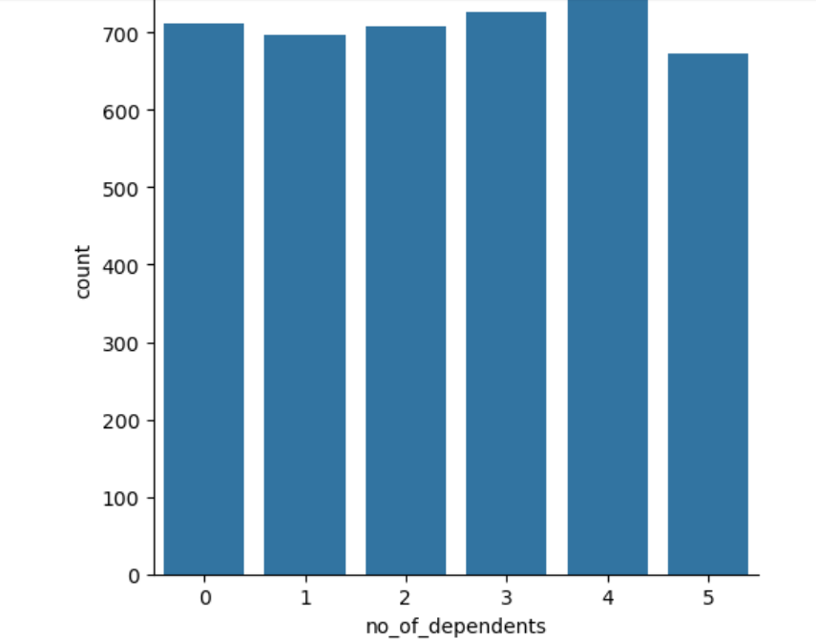
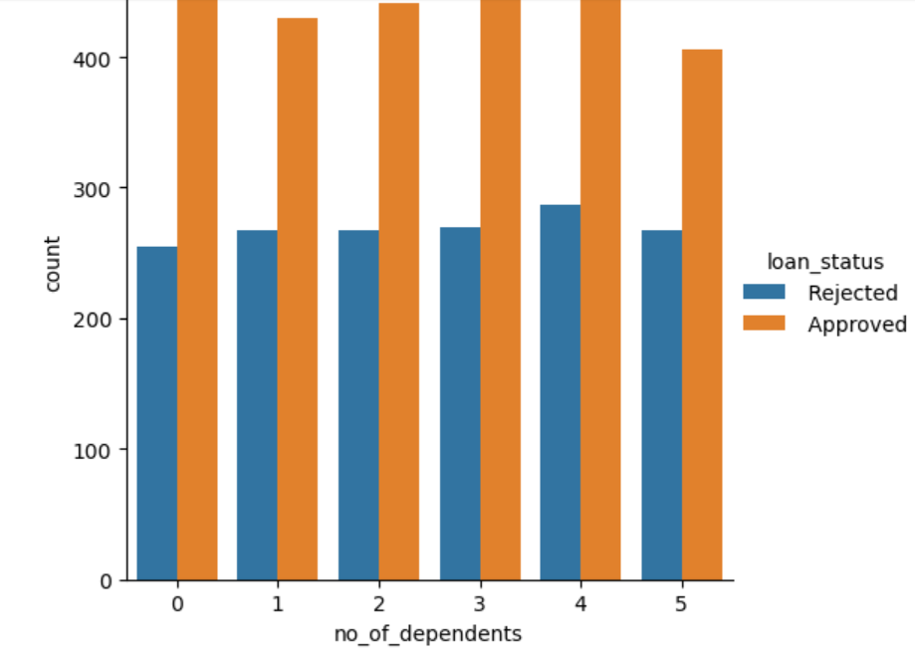
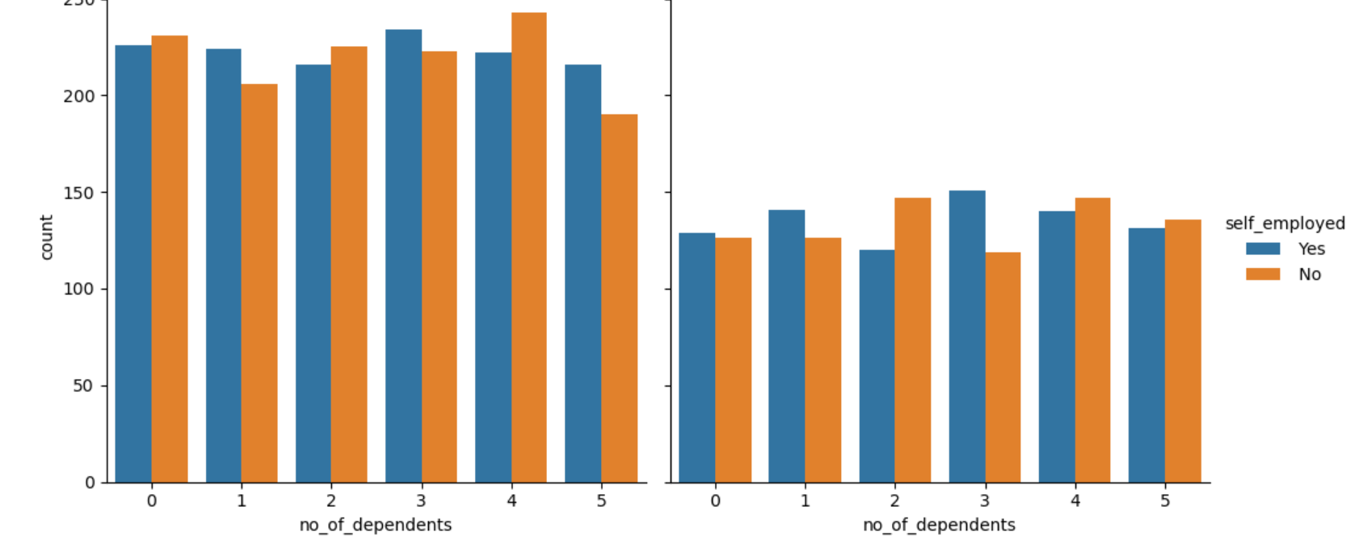
RECREATION DESIGN
Categorical Plots are shown here
Insight : From here we can observe if the person has less dependents the probability that his loan will be approved is more .
Insight : From this cat plot with no of dep =4 is highest and dep=5 is lowest
Insight : Here, no_of_dependents of loan_status = Approved chart has more count as compared to loan_status = Rejected.

Slide 9




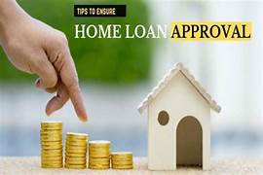
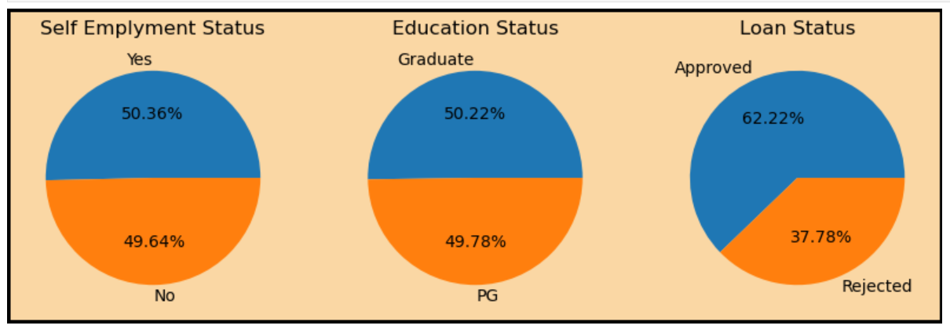
RECREATION DESIGN
Here, Subplot are shown. In That, There are Pie Chart Are Shown.
Insights : Here, Self Employment Status is more as compared to non-self employment status. Education Status of Graduate is more as compared to PG Student. So, finally the Loan Status Of Approved is more i.e. 62.22% as compared to Rejected i.e. 37.78%

Slide 10
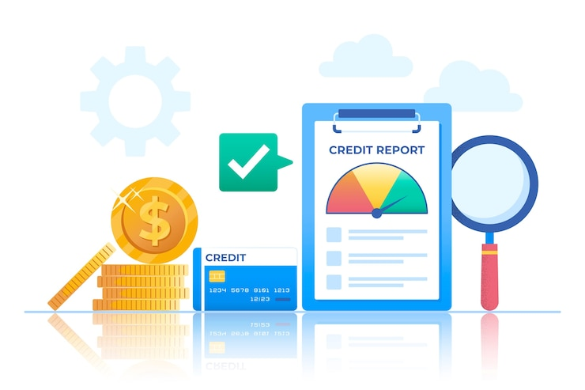

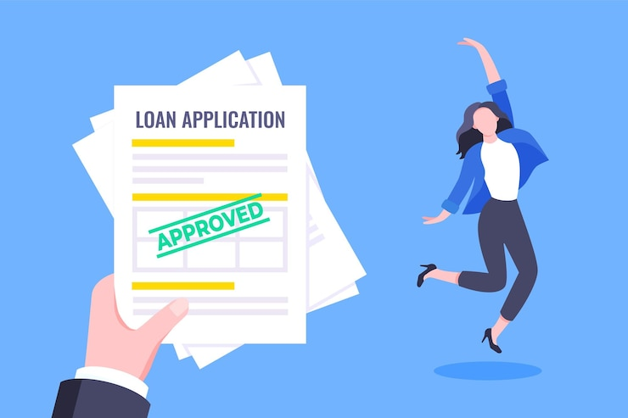
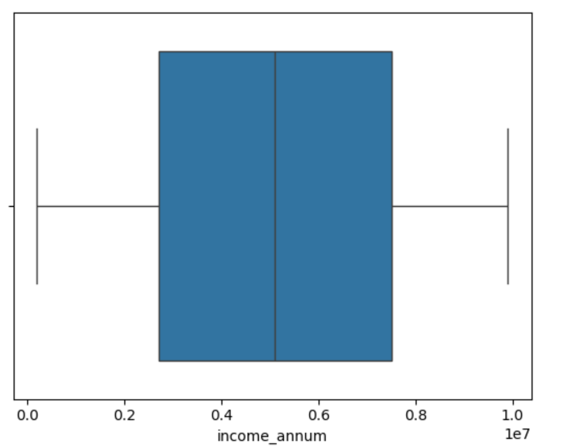
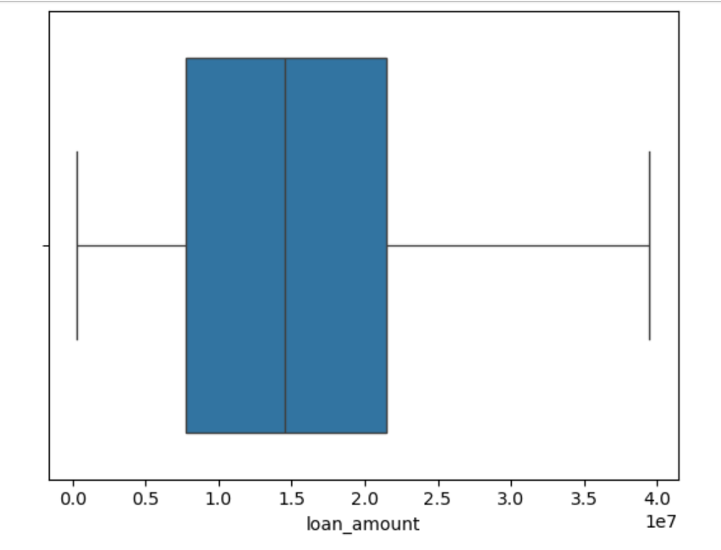
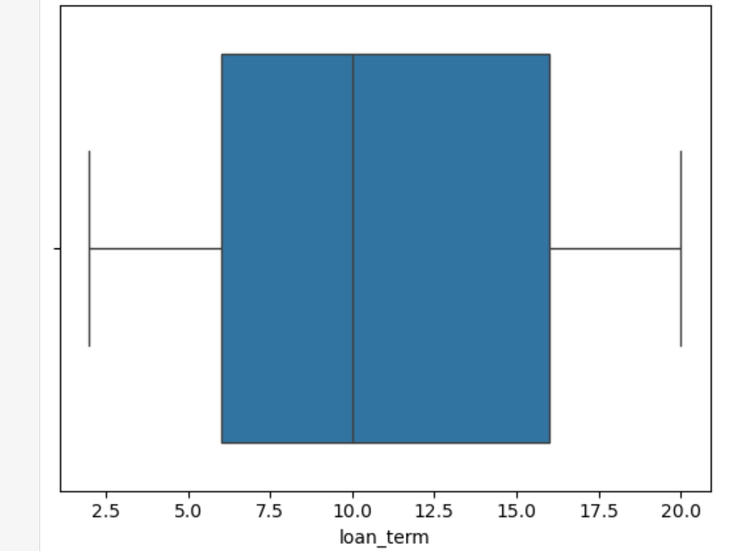
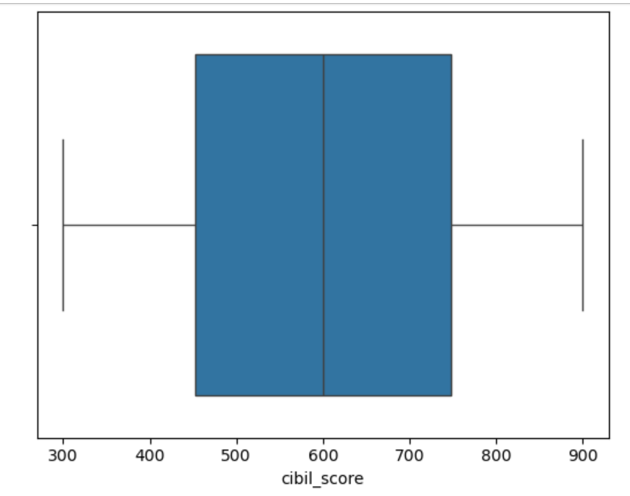
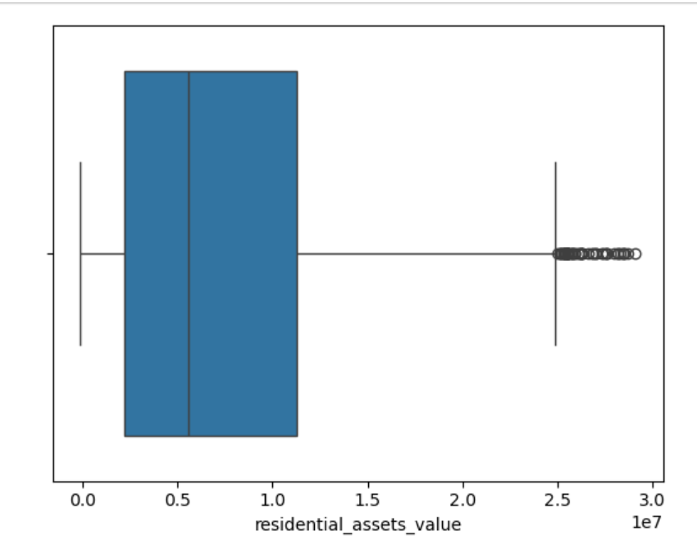
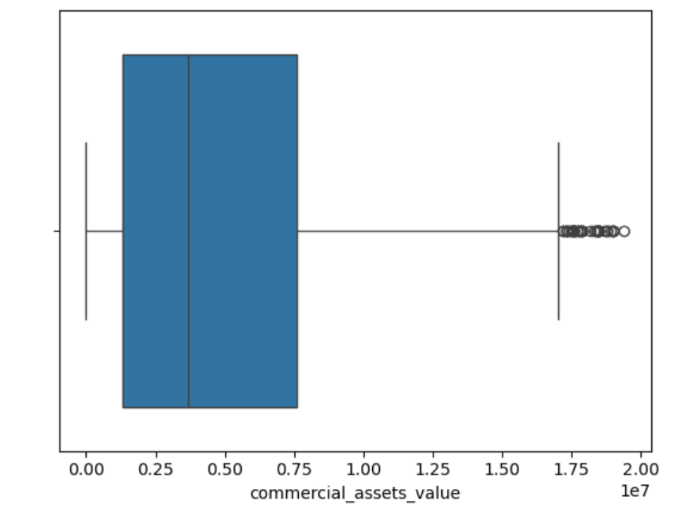
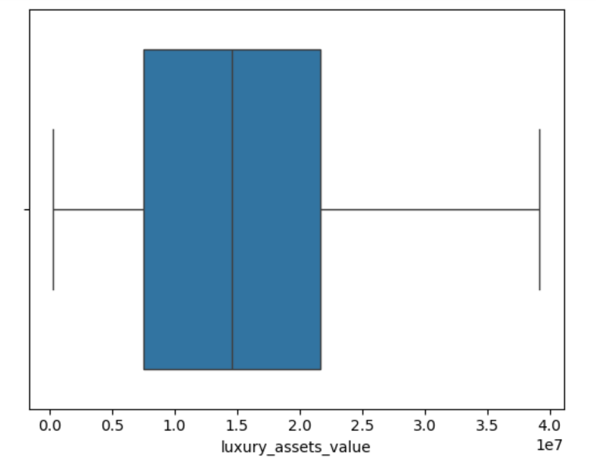
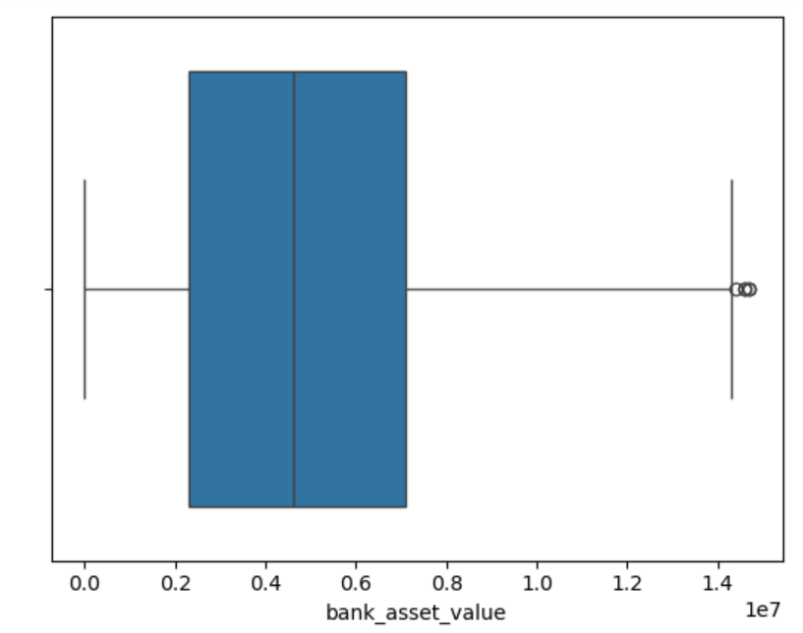
RECREATION DESIGN
BOX PLOT are shown here
Insights : Here, Box Plot have been shown for income_annum, loan_amount, loan_term, cibil_score, residential_assets_value, commercial_assets_value, luxury_assets_value & bank_asset_value.

Slide 11



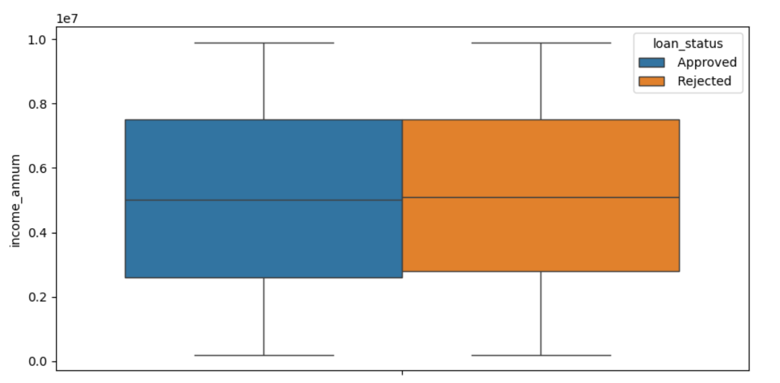
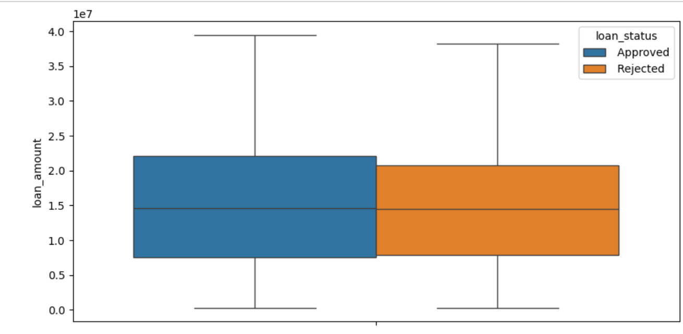
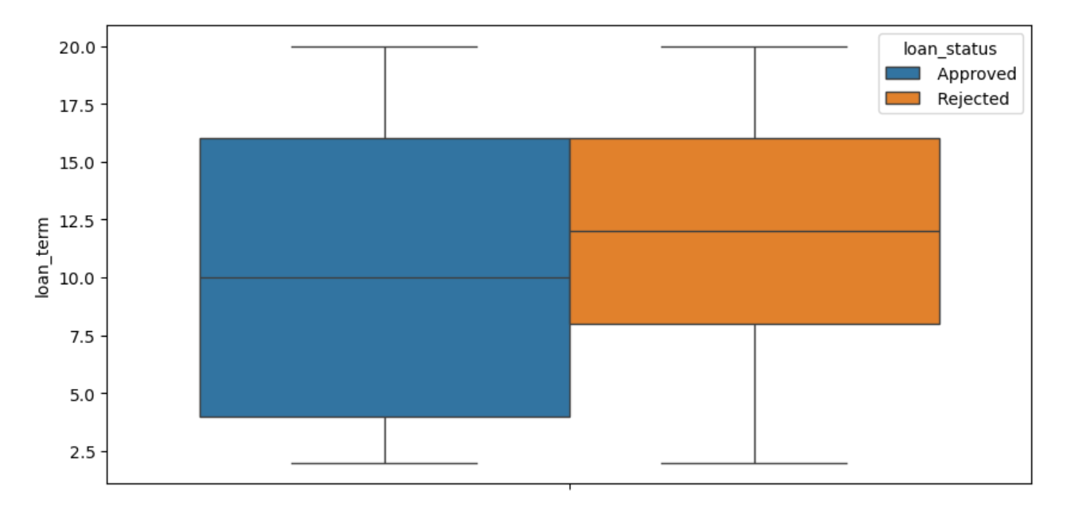
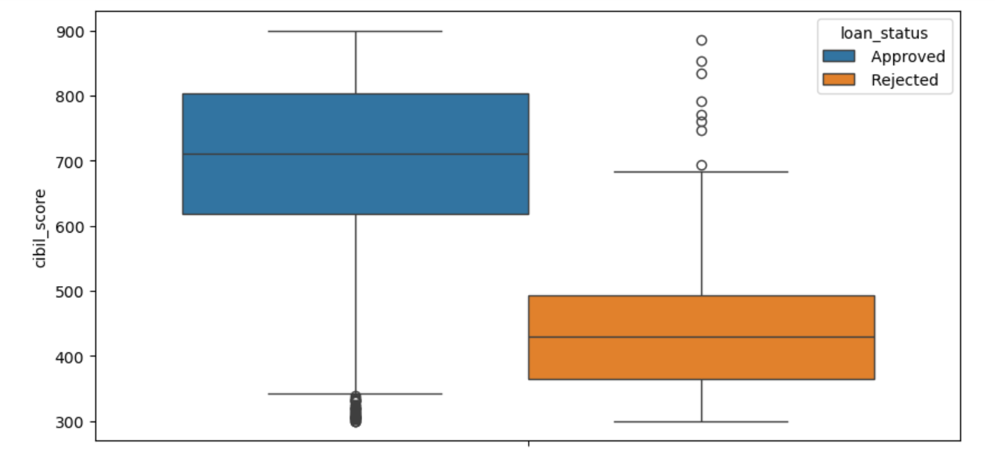
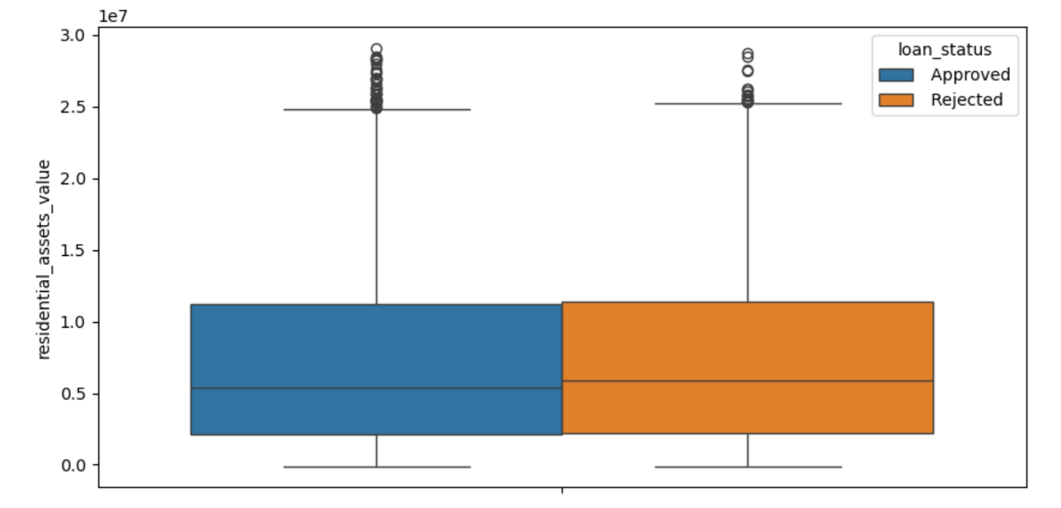
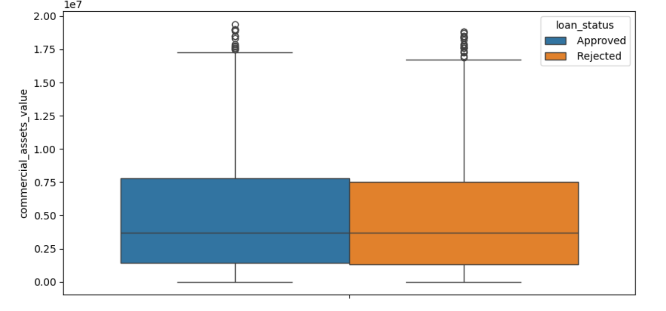
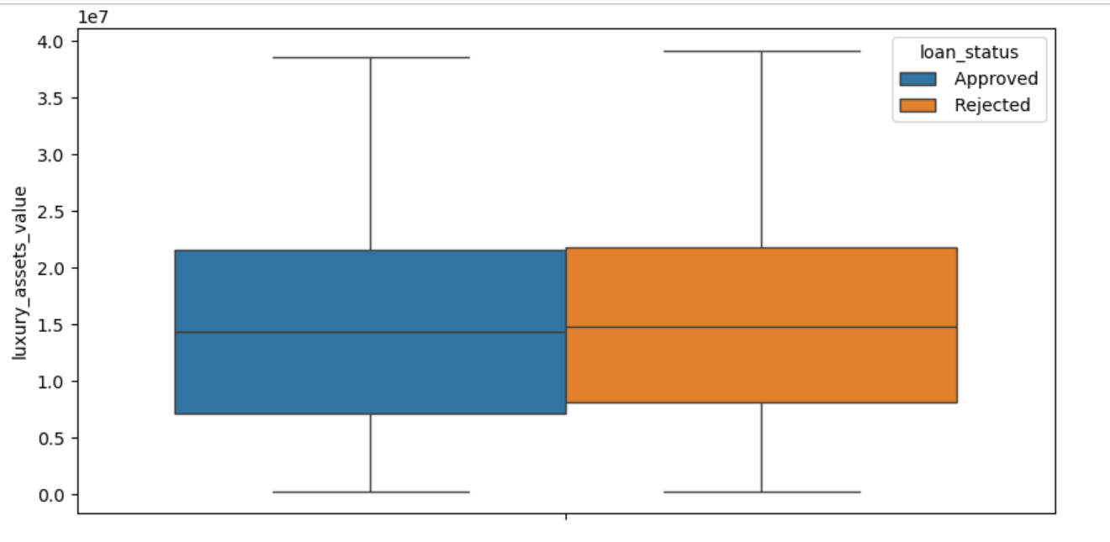
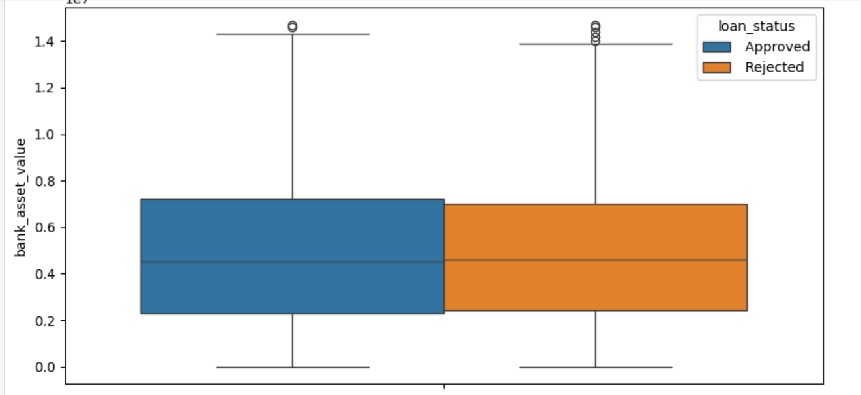
RECREATION DESIGN
BOX PLOT are shown here
Insights : Here, Box plot of loan_status have been shown. Approved loan_status have shown in Blue Color & Rejected loan_status have shown in Orange Color. Here, loan_status are shown for different categories differently.

Slide 12



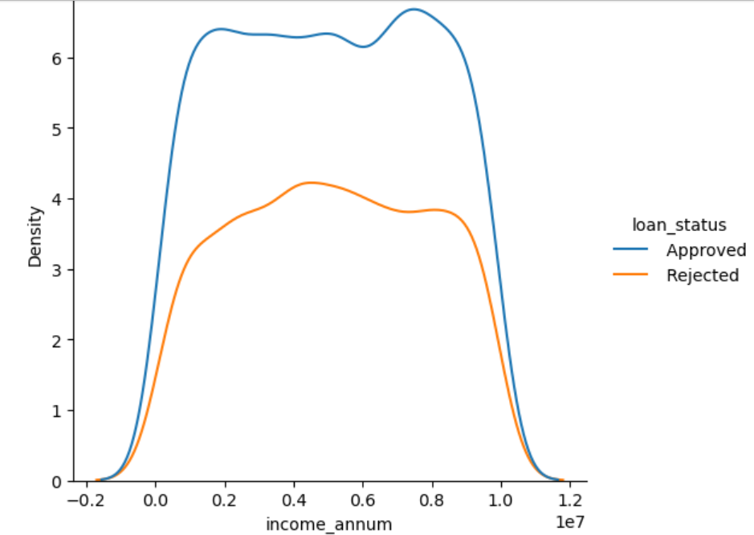
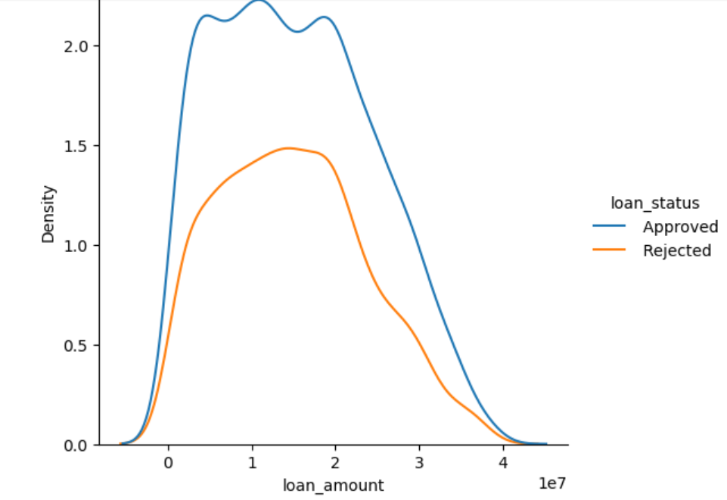
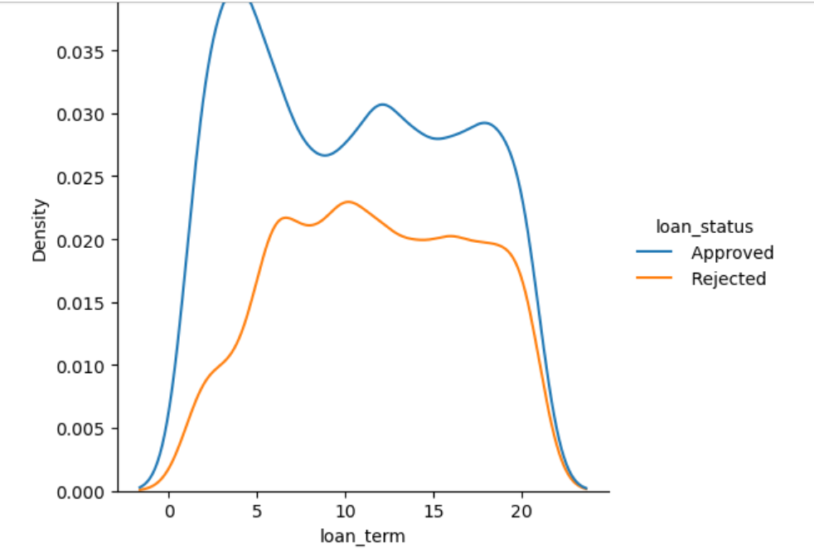
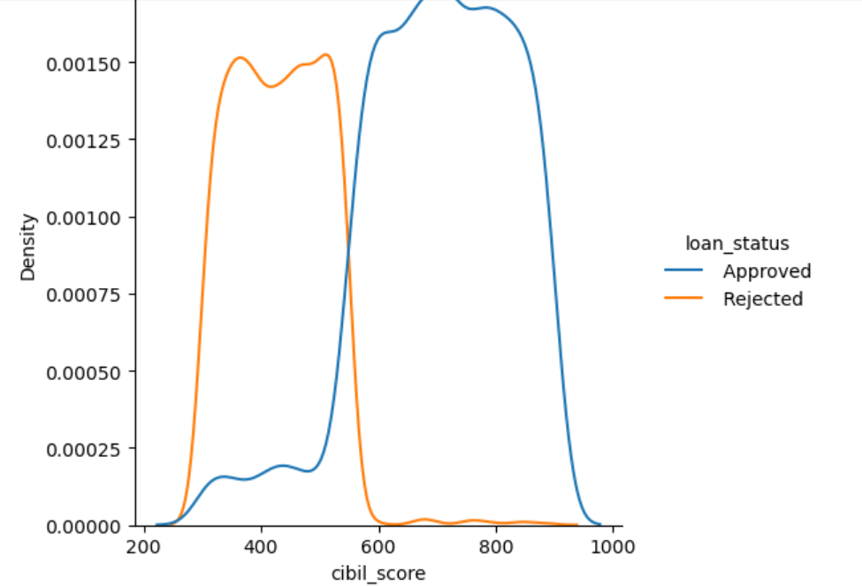
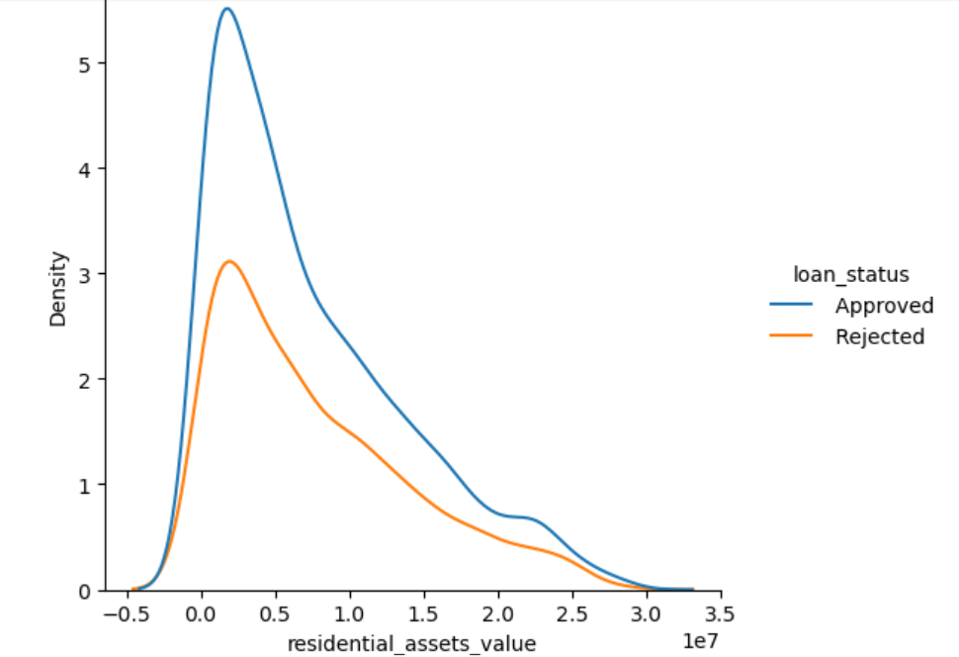
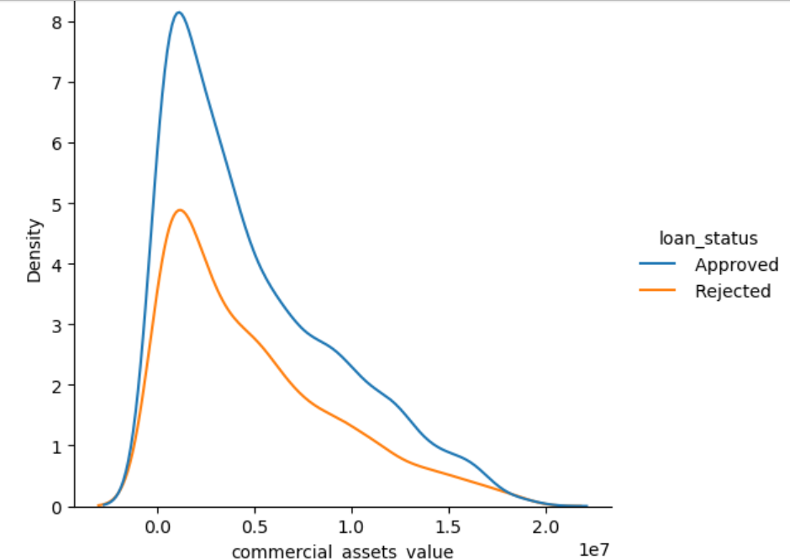
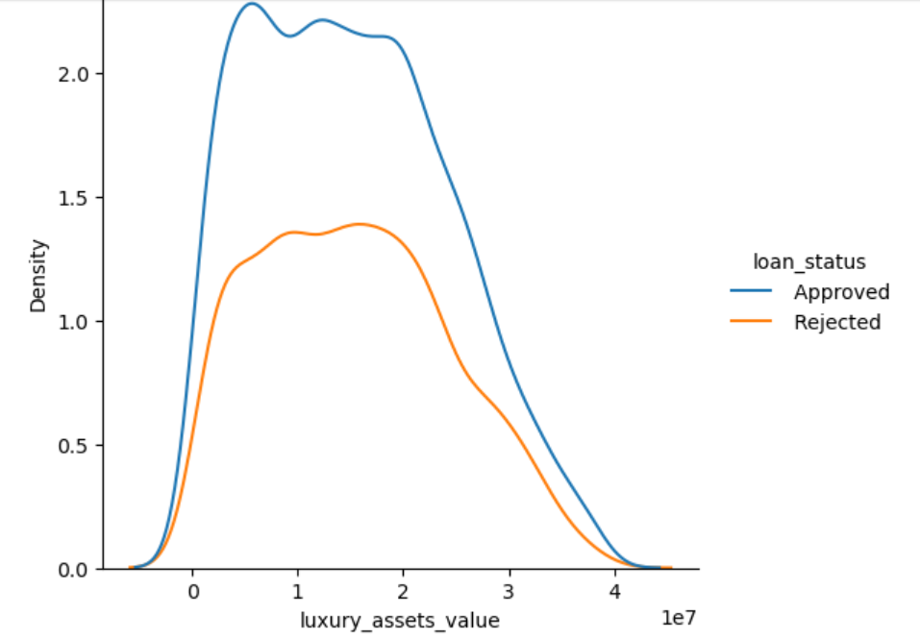
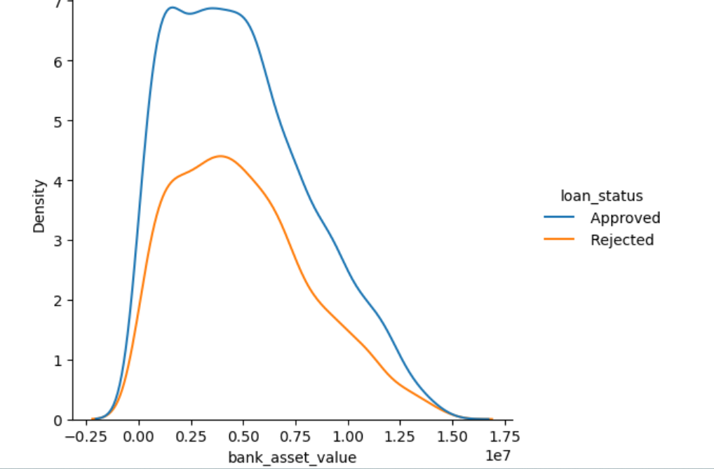
RECREATION DESIGN
Distribution PLOT are shown here
Insights : Here, Distribution Plot shows the Density wise loan_status. Also, loan_status of Approved have shown in Blue color & loan_status of Rejected have shown in Orange color by list .

Slide 13


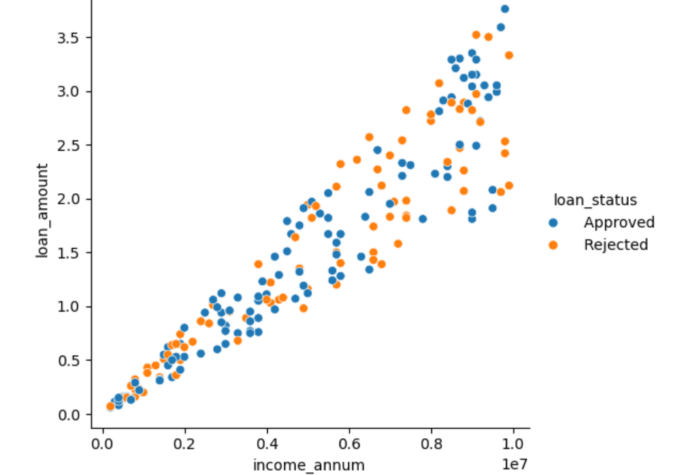
RECREATION DESIGN
Relational PLOT are shown here
Insight : As the income increses the loan amount also increases .

Slide 14
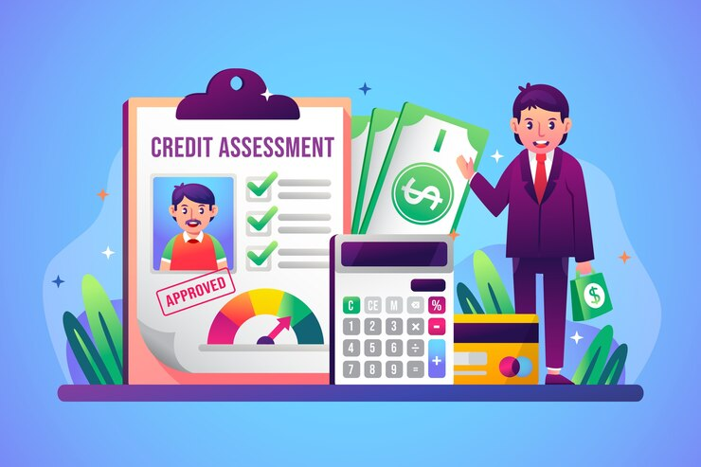


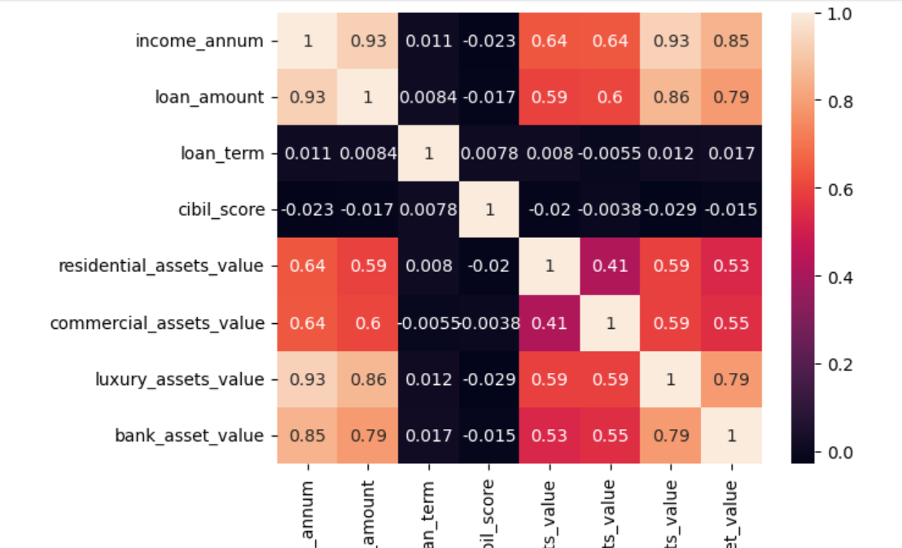
RECREATION DESIGN
Heat Map are shown here
Insights : Here, Heat Map shows the Correlation Matrix. From this we can observe that most of the asset values and annual income are highly correlated. cibil score, loan term has no relation with annual income .

Slide 15
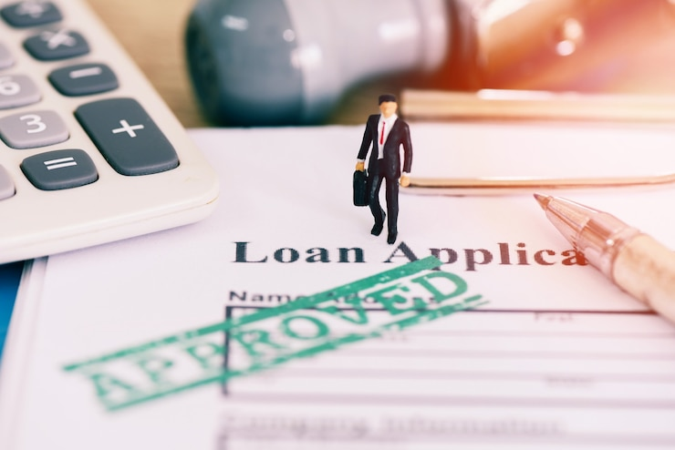


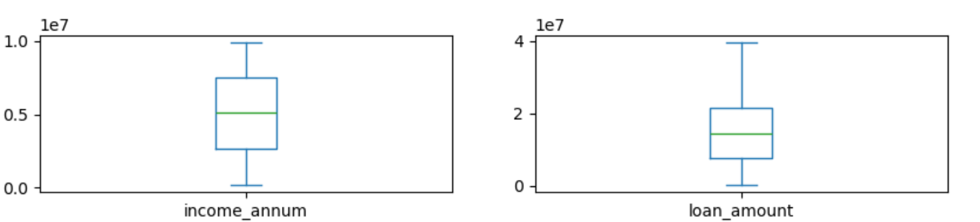
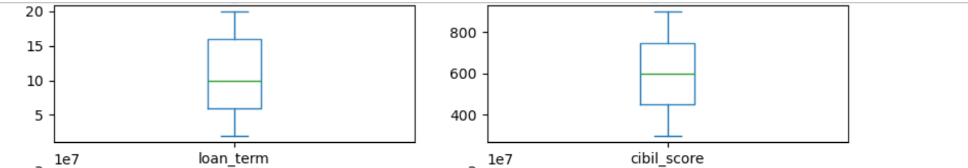
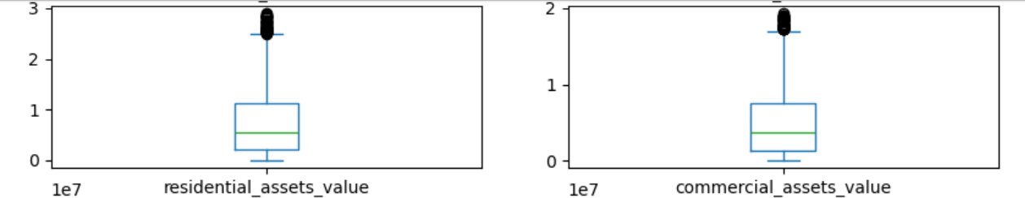
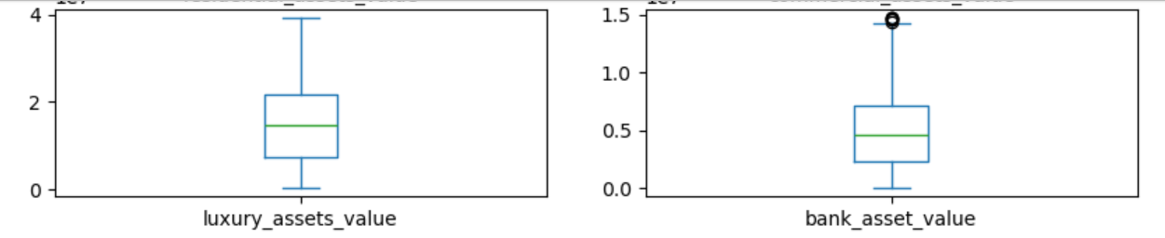
RECREATION DESIGN
Box Plot are shown here
Insights : Here, Box Plot shows the Outlier Removal Treatment.

Slide 16



Here, Label Encoding, Scaling & Hyperparameter Tunning are used
Algorithms used :
1. Logistic Regression
2. Decision Tree
3. Random Forest
4. SVM
5. Naive-Bayes
6. K-Nearest Neighbors

Slide 17

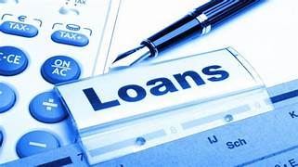
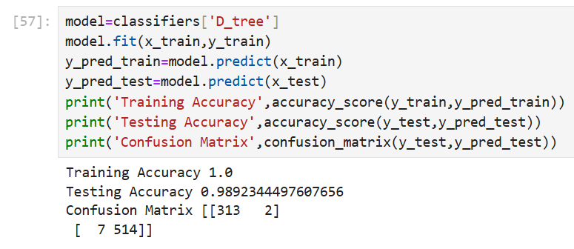
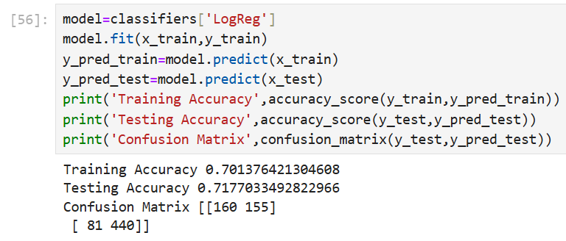
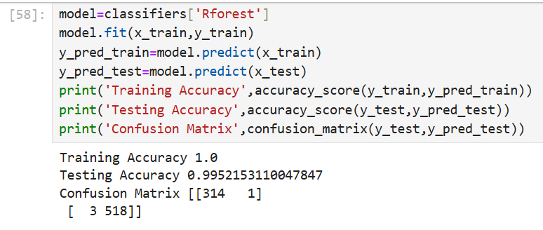
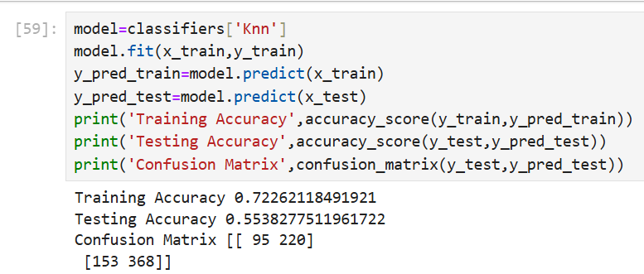


RECREATION DESIGN
Algorithms & their Accuracy

Slide 18




RECRATION DESIGN
Conclusion
1.From The above slide we can say that Logistic Regression, Decision Tree, Random Forest Classifier, SVM, Naïve Bayes & K Nearest Neighbors are giving good Accuracy .
2. But, the Decision Tree, Random Forest Classifier & Naïve Bayes gives Best Accuracy.
3. I have Applied KNN Algorithm For Classification Report. Precision, Recall, F1-Score, & Support are Good in K Nearest Neighbors Algorithm
4. Accuracy Of Training is 72% & Testing Set Score is 55%. i.e. Our Model have Good Training & Testing Accuracy for KNN Imputer.

Slide 19



RECREATION DESIGN
Evaluation
From The Below Evaluation slide, we can say that Precision, Recall, F-1 Score & Support is Good for our Model .
Class 0 Recall Value is 19% i.e It is Low But Good Not So Bad. & Overall Accuracy Of our Model is 58.73% i.e. Low Bot good Not So Bad For KNN Algorithm. So, Our Model has Good Accuracy. Our Model is Good to Perform.

Slide 20




RECREATION DESIGN
Insights
On the Real – Time Data Analysis, Based on Target Column i.e. loan_status. Here, Approved & Rejected Loan_Status are shown by picture.
Loan Status Approved Person
Loan Status Rejected Person

Slide 21


Future_Scope
Integration with Banking Systems : The model can be integrated into existing banking software to automate real-time loan approvals, making the system more efficient and scalable.
. Expansion to Different Loan Types : The system can be extended to handle various types of loans like home loans, personal loans, car loans, education loans, etc., with tailored prediction models for each.
Incorporation of Additional Features : Future iterations can include more features such as credit scores from external agencies, social media activity (for informal sector applicants), and alternative income verification.
Model Optimization and Tuning : Advanced hyperparameter tuning and usage of ensemble methods can further improve the performance and reliability of predictions.
Real-time Fraud Detection : The system can be enhanced to flag potentially fraudulent applications based on anomalous patterns in the data.
Deployment on Cloud Platforms : For wider accessibility and scalability, the model can be deployed on using Streamlit library & using App1.py file & using Anaconda Prompt for deployment.
Mobile and Web Application Development : A user-friendly app or web portal can be developed for customers to check eligibility and get instant loan approval predictions.
8. Continuous Learning : The model can be set up to retrain periodically with new data, improving its accuracy and adapting to changing trends and policies.
9. Regulatory Compliance and Fairness Audits : Future systems can include mechanisms to ensure compliance with financial regulations and conduct fairness audits to avoid biased decisions.

Slide 22








RECREATION DESIGN
Best Algorithm For Prediction : Random Forest i.e. Training Accuracy : 100% & Testing Accuracy : 99.28%

Slide 23







RECREATION DESIGN

